Slide 2
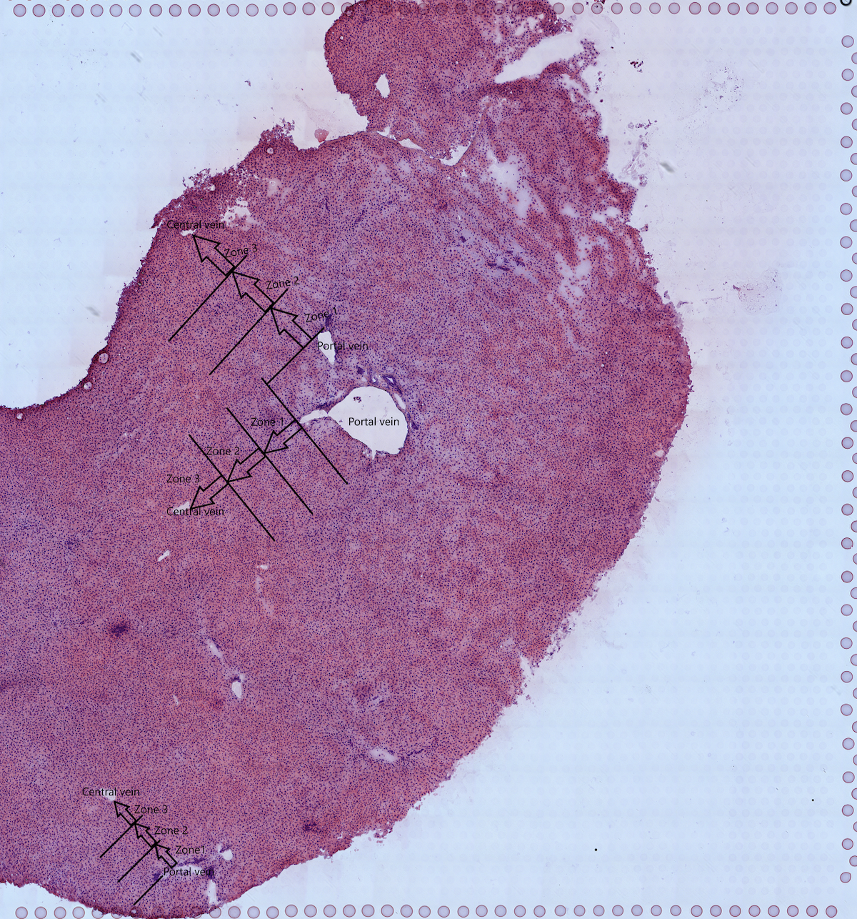
Periportal upregulated pathways
Pericentral upregulated pathways

